Slide 1
BY, Cool Dudes
Stock market ANALYSIS and Prediction

Slide 2
Why Stock Market Analysis is essential?
The stock market is the main source of the companies that want to raise funds for their expansion. Hence, Performing a research on the company and it’s past stock performances before making an investment is a must.
The stock market analysis helps you to understand and predict future price movement and gauge whether a stock is undervalued or overvalued. At the same time, it helps you analyze a company’s strength and its ability to beat its competitors.
Although technical analysis does not result in absolute predictions, it can help investors anticipate what is "likely" to happen to prices over time.​

Slide 3

How to Evaluate different stocks performance in the near future?
Evaluating the performance of a stock requires more than just simply looking at the change in its price over time.
One needs to understand the stock’s performance over years, look at how the stocks has done Year To Date (YTD), as well as over the past 52 weeks with respect to volumes of stocks exchanged.
Let’s dive in deeper and understand the various methods of analysis involved in evaluating a stock performance

Slide 4
Introduction to Stock Market
Stock or Share of a company is a portion of ownership in the corporation.
It is a way for a corporation to raise money initially.
The companies are listed in Stock Exchanges, through which all trades are executed.
Stock exchanges monitor and regulate all transactions related to the trading of shares
Stocks are classified into 4 categories namely:
Based on market Capitalization
Based on Domain of operation
Private sector and Public Sector(PSU)
Growth stocks and Value Stocks

Slide 5
classification | Market Cap | Popular Example
Large cap | More than 40,000 crores | TCS, Reliance, SBI
Mid cap | More than 10,000 crores | TATA Power, ZEE ltd, Mindtree
Small cap | 1000 to 10,000 crores | VRL Logistics,Narayana, Hrudayalaya
Based on market Capitalization
Sector of operation | Popular stocks
IT Industry | Infosys, TCS, HCL Tech, Wipro
FMCG | ITC, Dabur, Patanjali Food
Metals and Mining | SAIL, NALCO, Vedanta
Energy | TATA Power, Adani Power
Banking | SBI, HDFC Bank, Axis Bank
Based on Domain of operation

Slide 6
Different Values of Stocks Exchange:
1) Open Values: It is the price at which the financial security opens in the market when trading begins. It may or may not be different from the previous day's closing price. The security may open at a higher price than the closing price due to excess demand of the security
2) Close Values: The closing price is the raw price, which is just the cash value of the last transacted price before the market closes. A stock's price is typically affected by supply and demand of market participants.
3) Adjusted Value: The adjusted closing price amends a stock's closing price to reflect that stock's value after accounting for any corporate actions. The closing price is the raw price, which is just the cash value of the last transacted price before the market closes.

Slide 7
4) High and Low Values: The 52-week high/low is the highest and lowest price at which a security has traded during the time period that equates to one year and is viewed as a technical indicator.
The 52-week high/low is based on the daily closing price for the security.
Typically, the 52-week high represents a resistance level, while the 52-week low is a support level that traders can use to trigger trading decisions.
5) Volume: Daily volume is how many shares are traded each day, but this can be averaged over a number of days to find the average daily volume.
Average daily trading volume is an important metric because high or low trading volume attracts different types of traders and investors.
Many traders and investors prefer higher average daily trading volume compared to low trading volume

Slide 8
Data Collection
The real time stock data is collected from Yahoo Finances.
Yahoo! Finance is a media property that is part of the Yahoo! Network. It provides real-time streaming quotes for many exchanges. Real-time data is available during an exchange's market hours, and in some cases during pre-market and post-market hours.
It mainly provides:
Facts and Information that includes Profile, Financials, Sustainability
Financial performance data that includes Chart, Statistics, Historical data
Some of major features of Yahoo Finance includes:
Company profile data provided by S&P Global Market Intelligence.
Financial statements, valuation ratios, market cap and shares outstanding data provided by Morningstar
Analyst estimates, earnings, corporate, economic events, non-US IPO, and insider transactions data provided by “Refinitiv” .

Slide 9
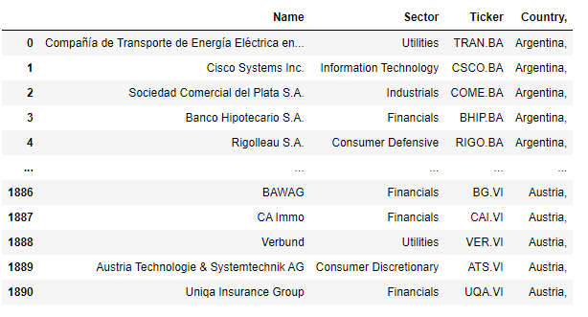
The above dataset contains the name of the top 1891 companies listed in Yahoo finance in over 50 countries around the world, including the NIFTY-50 stocks which is stored with their respective sectors, stock symbol and country details.
The real time stock data for each company is obtained from Yahoo! Finance with the help of respective “Ticker” of the company which is matched in the dataset once the user selects the company from the dropdown menu in the home page.

Slide 10
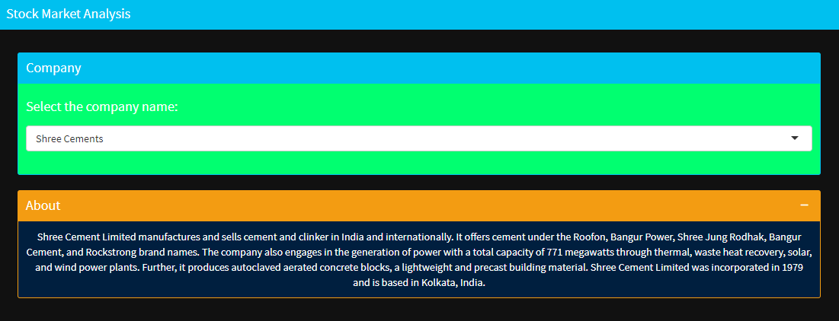
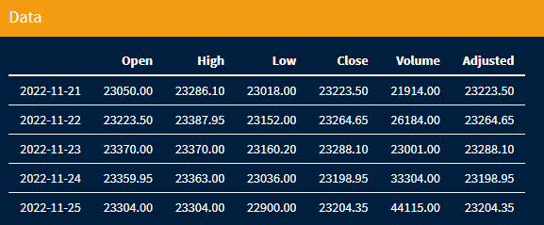
Selection of company name also gives the Company's Profile which includes:
Company background
Products/Services
Company history
Sector and Industry
The stock information obtained is then used to visualize, analyze and to forecast the data.

Slide 11
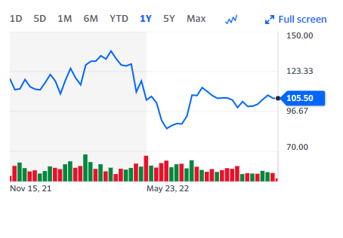
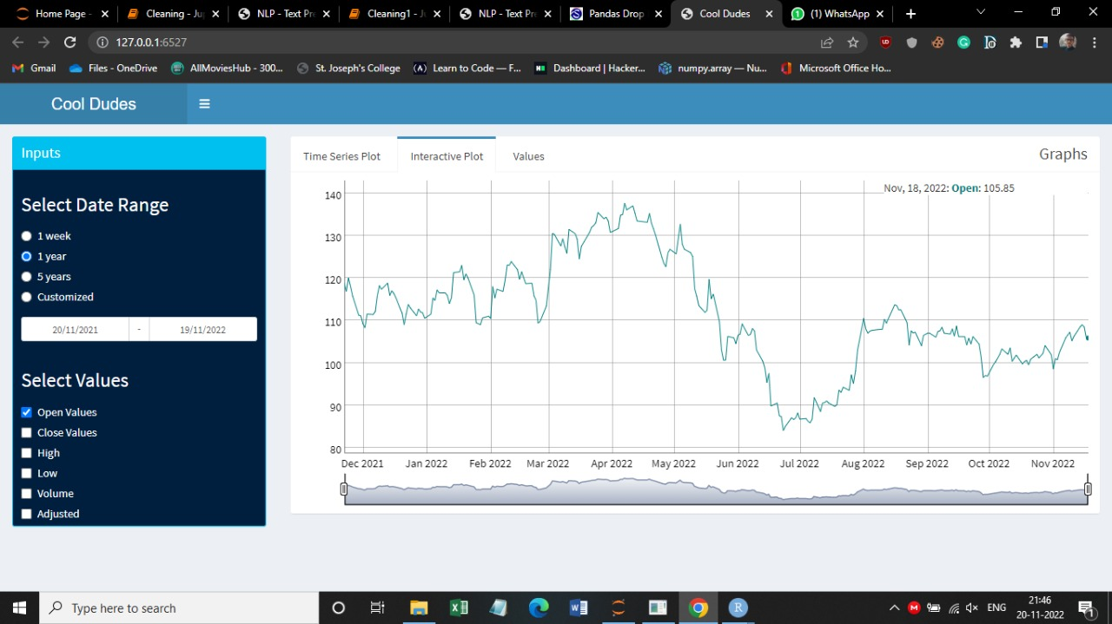
An example of the data collected from yahoo finance which is analyzed and then plotted using a time series graph is as follows:
Tata Steel Ltd (As viewed in Yahoo Finance)
Tata Steel Ltd (As viewed in the developed Project)

Slide 12
Time Series Plot
Time series data is a sequence of data points in chronological order that is used by businesses to analyze past data and make future predictions.
It is a graph that displays various price of a stock investment over a period of time.
Time series analysis can be useful to see how a given asset, security, or economic variable changes over time. It also can be used to examine how the changes associated with the chosen data point compare to shifts in other variables over the same time period.
It is also used to plot the volumes of stocks exchanged over a period of time.
The main purpose of a time series plot is to know the current prices of a stock investment and how it’s price has changed over time. The time series forecasting uses information regarding historical values and associated patterns to predict future activity.

Slide 13
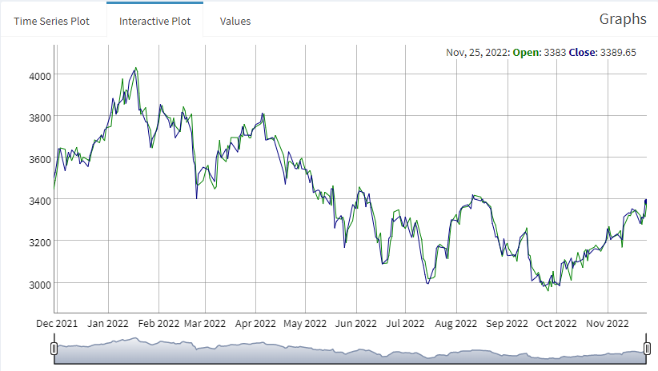
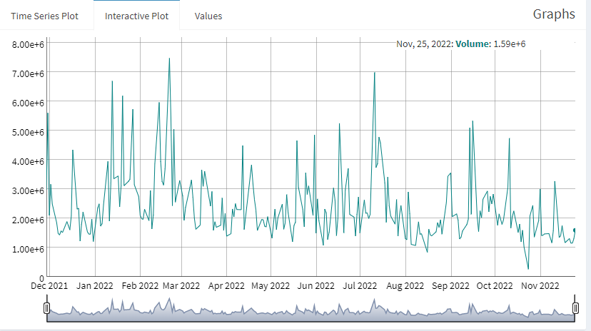
The time series graph for opening and closing prices and volume of the stocks traded of the company “Tata Consultancy Services (TCS)” in past 1 year is depicted below:

Slide 14
RSI INDICATOR & Bollinger bands
The relative strength index (RSI) is a momentum indicator used in technical analysis.
RSI measures the speed and magnitude of a stock's recent price changes to evaluate whether it is overvalued or undervalued
If the RSI score is above 70, its not the right time to buy.
If RSI goes below 30, depending on the fundamentals of the stock positions can be taken.
A Bollinger Band is a technical analysis tool defined by a set of trend lines plotted two standard deviations (positively and negatively) away from a simple moving average (SMA) of a security's price.
When stock prices continually touch the upper Bollinger Band, the prices are thought to be overbought; conversely, when they continually touch the lower band, prices are thought to be oversold, triggering a buy signal.
When the two are combined, the RSI acts to either support or dispel possible price trends. For example, if a stock price reaches the upper band of a Bollinger Band price channel and, at the same time, the RSI reads 70+, the trader could make the interpretation that the security is overbought.

Slide 15
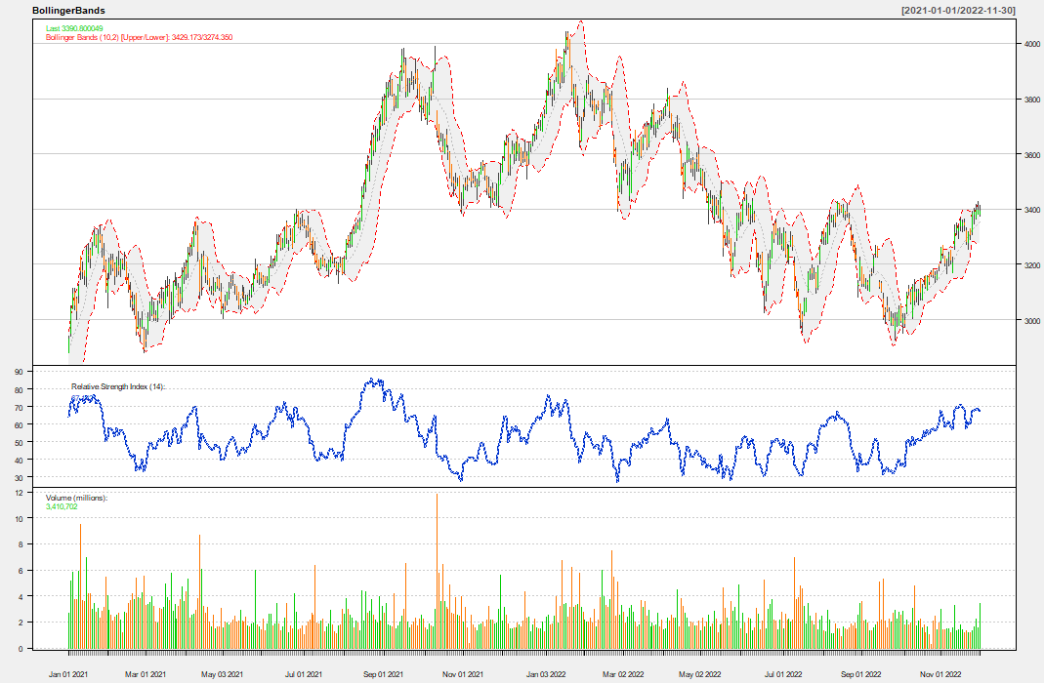
Bollinger bands with RSI CURVE (TCS)

Slide 16
MACD & GOLDEN CRoss
The Moving Average Convergence/Divergence(MACD) indicator is a bar that shows the association between two moving averages of a security's price to track trend momentum. The MACD line is calculated by subtracting the 26-period EMA from the 12-period EMA.
The MACD Histogram represents the difference between MACD and its 9-day EMA, the signal line.
When the MACD is positive, and the histogram is increasing, it indicates that momentum is building. In this instance, the price tends to rise, which can be regarded as a "busy" indication.
When MACD and the histogram value both decreases, it indicates that the price is most certainly falling and that the assets should be sold.
Golden cross is used to describe a situation in which the short-term 50-day moving average, crosses above its long-term moving average, such as the 200-day moving average.
It indicates that the stock is in upward momentum. Some investors use the Golden Cross as a buying signal. While others use it as a confirmation of a stock’s strength after it has already begun to move higher.

Slide 17
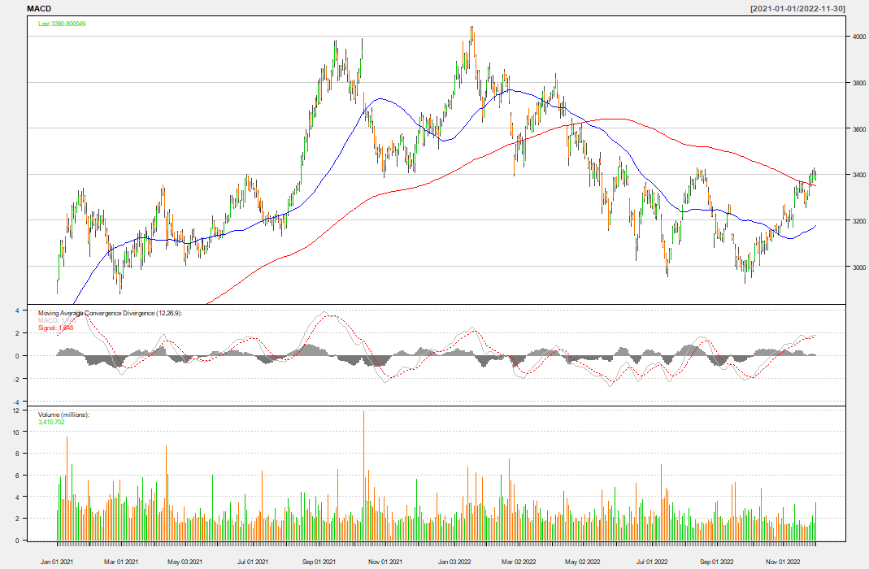

Slide 18
ARIMA MODEL
An autoregressive integrated moving average, or ARIMA, is a statistical analysis model that uses time series data to predict future trends.
It is widely used in demand forecasting.
A seasonal ARIMA model is formed by including additional seasonal terms in the ARIMA. The seasonal part of the model consists of terms that are very similar to the non-seasonal components of the model, but they involve backshifts of the seasonal period.
It uses past values to predict but also takes into account any seasonality patterns underlying in the data.
The non seasonal ARIMA model means that the seasonal components are estimated even if there are no signs of the presence of seasonal fluctuations in the time series.
A key aspect of non seasonal ARIMA models is that in their basic form, they do not consider exogenous variables. Rather, the forecast is made purely with past values of the target variable.

Slide 19
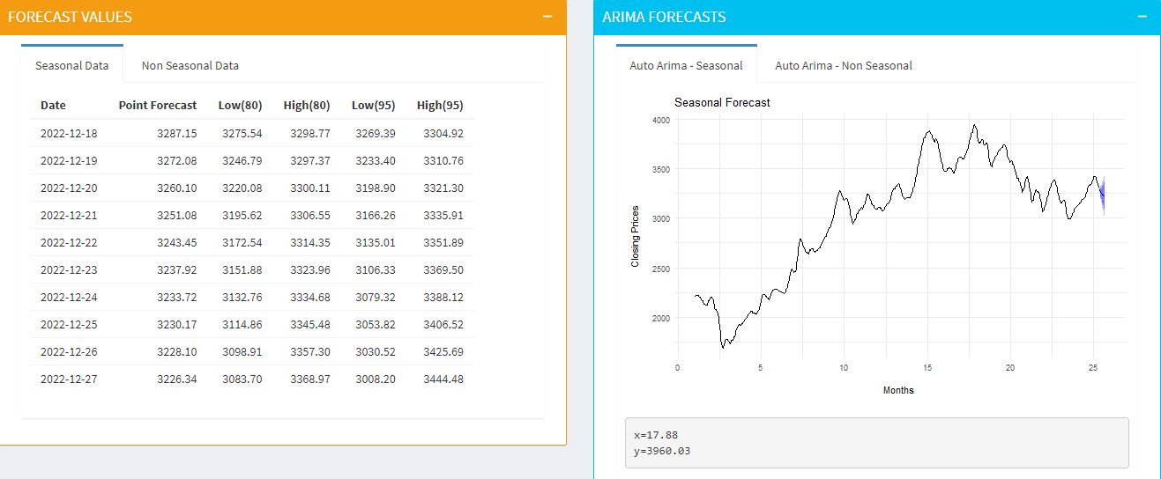
ARIMA MODEL- seasonal (TCS)
The Auto ARIMA is being used to predict the closing prices of the stock up to next 30 days. It gives us the point forecast values, and also the lowest and highest value of the day with 80 and 95 percent confidence intervals.

Slide 20
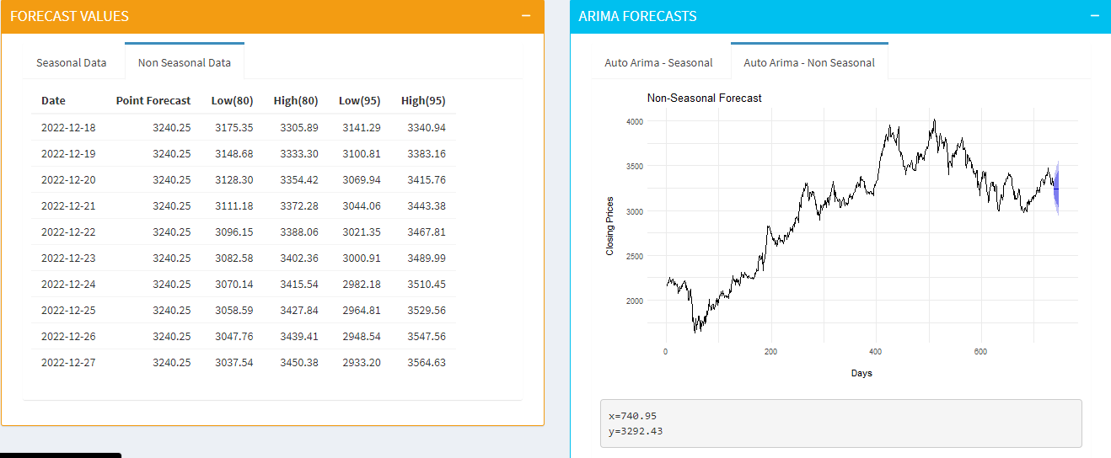
ARIMA MODEL- NON seasonal (TCS)

Slide 21

Key takeaways & challenges:
A brief understanding of the working of stock market and it’s components.
The understanding behind different concepts and graphs like Time Series, Moving averages, ARIMA model etc.
One of the many challenges throughout the duration of this project was learning the various implementations of R shiny and its enriched vast packages. But, eventually learnt a lot about R shiny and it’s features along with some truly amazing packages like “forecast”, “TTR” etc.

Slide 22

Potential Area Of Improvements!
The ARIMA components takes some time to get loaded on the front end, this can be improved by faster optimized computations.
More graphs and plots can be introduced to order to get an in-depth knowledge of the stock exchanges.
Predictions are made using Auto ARIMA model, but in order to get even more accurate predictions one can introduce the various market and business factors.
The design of front end can be improved and made more attractive.

Slide 23

Thank You
Presented by,
cool dudes
Karan Agrawal B (TL): 222bda56
Shashanka B P: 222bda50
Jibin Joseph: 222bda55
Nagarathna R: 222bda39
Sreenidhi Karanam: 222bda20
Sachidananda Rautray: 21bda58
Rachel Roshani J: 222bda42

